Slide 1
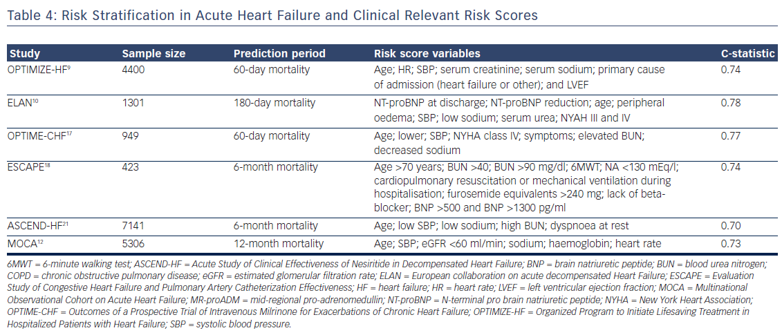
Chioncel O, Collins SP, Greene SJ, Pang PS, Ambrosy AP, Antohi EL, Vaduganathan M, Butler J, Gheorghiade M
Table 4: Risk Stratification in Acute Heart Failure and Clinical Relevant Risk Scores
Citation: Cardiac Failure Review 2017;3(2):122–9.
https://doi.org/10.15420/cfr.2017:12:1

