Slide 1
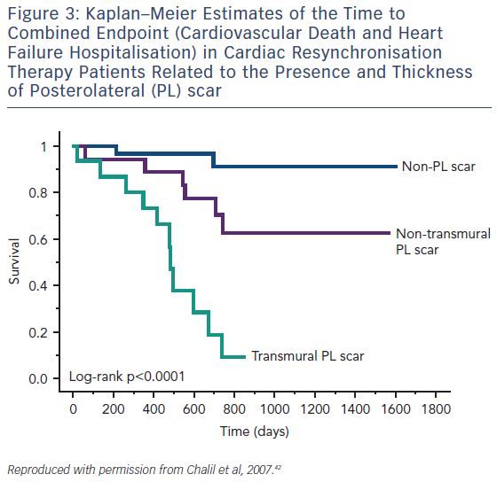
Adam RD, Shambrook J, Flett AS
Figure 3: Kaplan–Meier Estimates of the Time to Combined Endpoint (Cardiovascular Death and Heart Failure Hospitalisation) in Cardiac Resynchronisation Therapy Patients Related to the Presence and Thickness of Posterolateral (PL) scar
Citation: Cardiac Failure Review 2017;3(2):86–96.
https://doi.org/10.15420/cfr.2017:19:1

