Slide 1
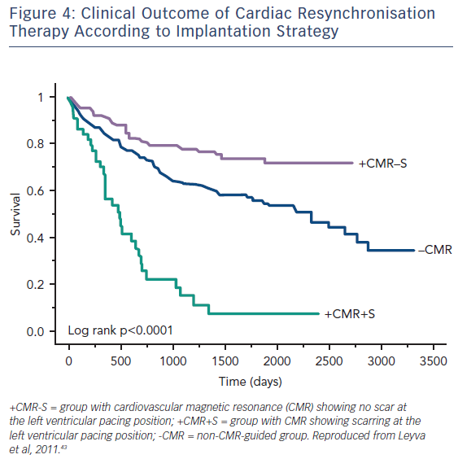
Adam RD, Shambrook J, Flett AS
Figure 4: Clinical Outcome of Cardiac Resynchronisation Therapy According to Implantation Strategy
Citation: Cardiac Failure Review 2017;3(2):86–96.
https://doi.org/10.15420/cfr.2017:19:1

