Slide 1
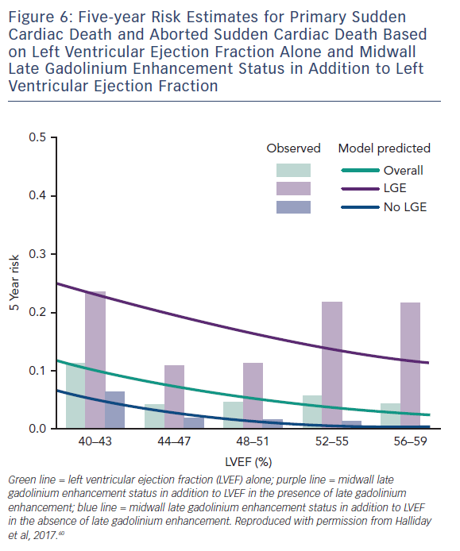
Adam RD, Shambrook J, Flett AS
Figure 6: Five-year Risk Estimates for Primary Sudden Cardiac Death and Aborted Sudden Cardiac Death Based on Left Ventricular Ejection Fraction Alone and Midwall Late Gadolinium Enhancement Status in Addition to Left Ventricular Ejection Fraction
Citation: Cardiac Failure Review 2017;3(2):86–96.
https://doi.org/10.15420/cfr.2017:19:1

