Slide 1

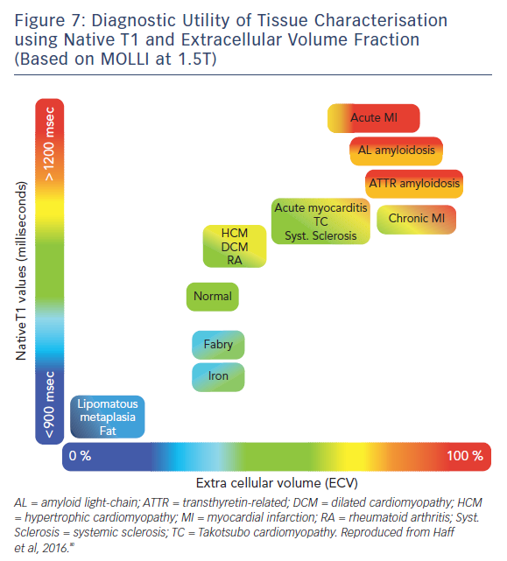
Adam RD, Shambrook J, Flett AS
Figure 7: Diagnostic Utility of Tissue Characterisation using Native T1 and Extracellular Volume Fraction (Based on MOLLI at 1.5T)
Citation: Cardiac Failure Review 2017;3(2):86–96.
https://doi.org/10.15420/cfr.2017:19:1

