Slide 1
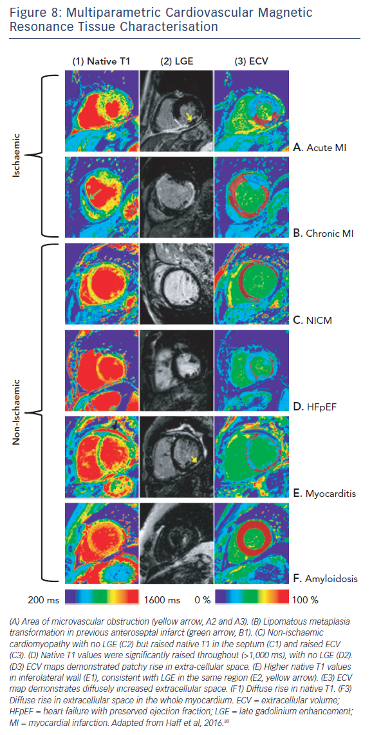
Adam RD, Shambrook J, Flett AS
Figure 8: Multiparametric Cardiovascular Magnetic Resonance Tissue Characterisation
Citation: Cardiac Failure Review 2017;3(2):86–96.
https://doi.org/10.15420/cfr.2017:19:1

