Slide 1

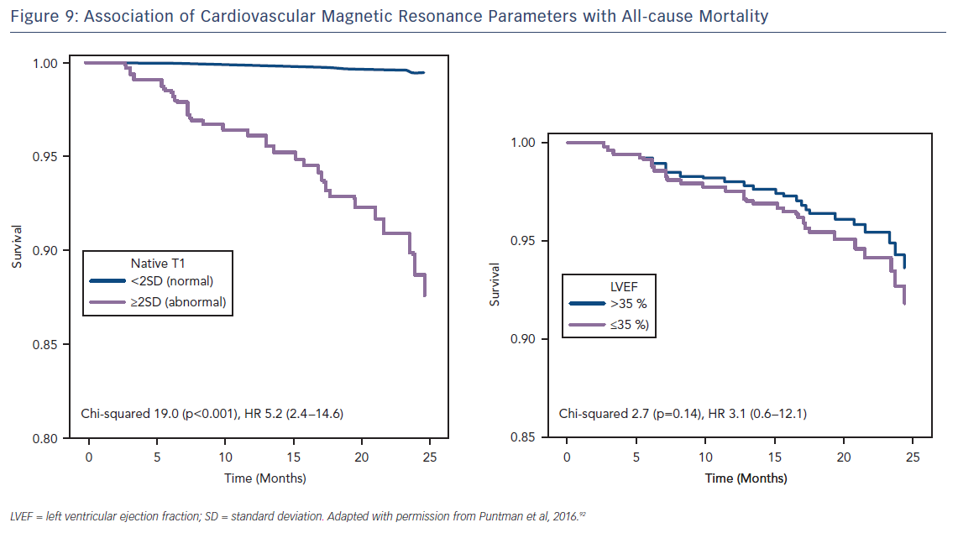
Adam RD, Shambrook J, Flett AS
Figure 9: Association of Cardiovascular Magnetic Resonance Parameters with All-cause Mortality
Citation: Cardiac Failure Review 2017;3(2):86–96.
https://doi.org/10.15420/cfr.2017:19:1

