Slide 1
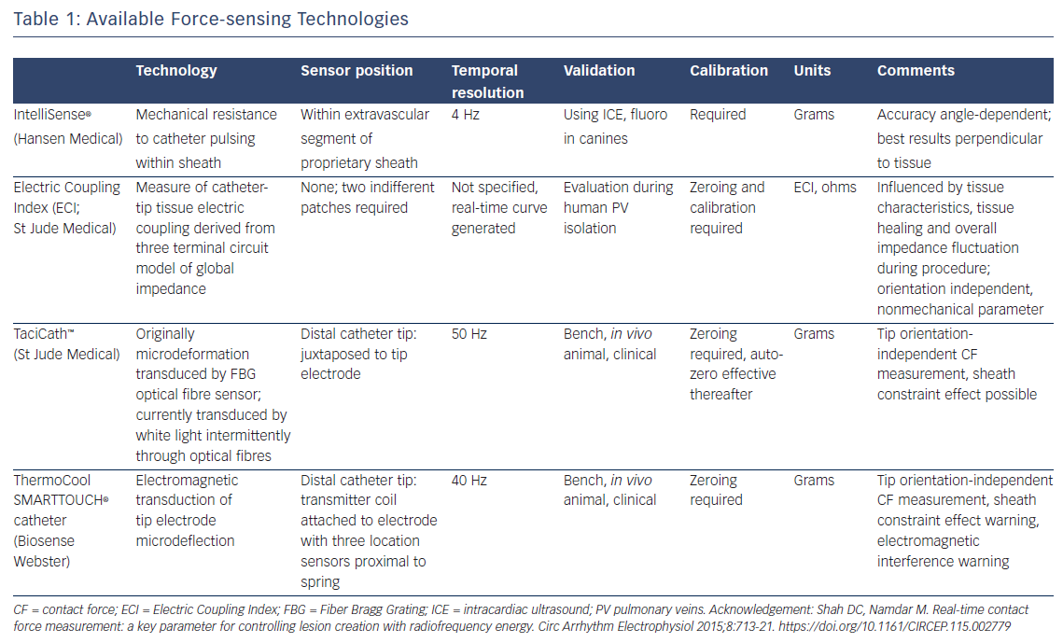
Duytschaever M, O’Neill M, Martinek M
Increasing the Single-Procedure Success Rate of Pulmonary Vein Isolation
Citation: Arrhythmia & Electrophysiology Review 2017;6(4):217–21.
https://doi.org/10.15420/aer.2017.38/1

