Slide 1
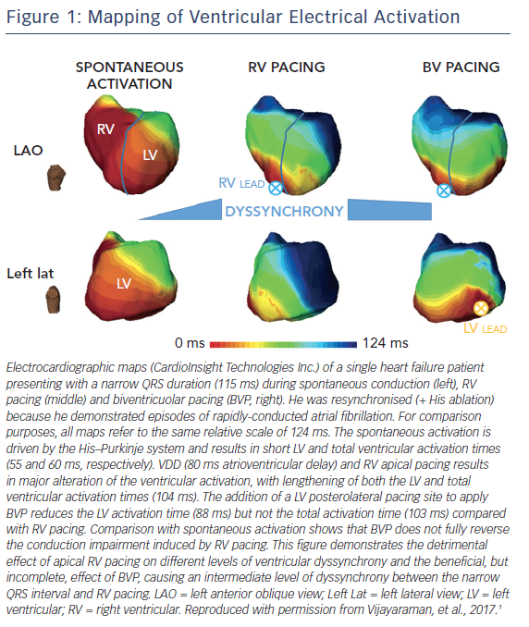
Katritsis DG
Figure 1: Mapping of Ventricular Electrical Activation
Citation: Arrhythmia & Electrophysiology Review 2017;6(4):159–60.
https://doi.org/10.15420/aer.2017.6.4:EO3

