Slide 1
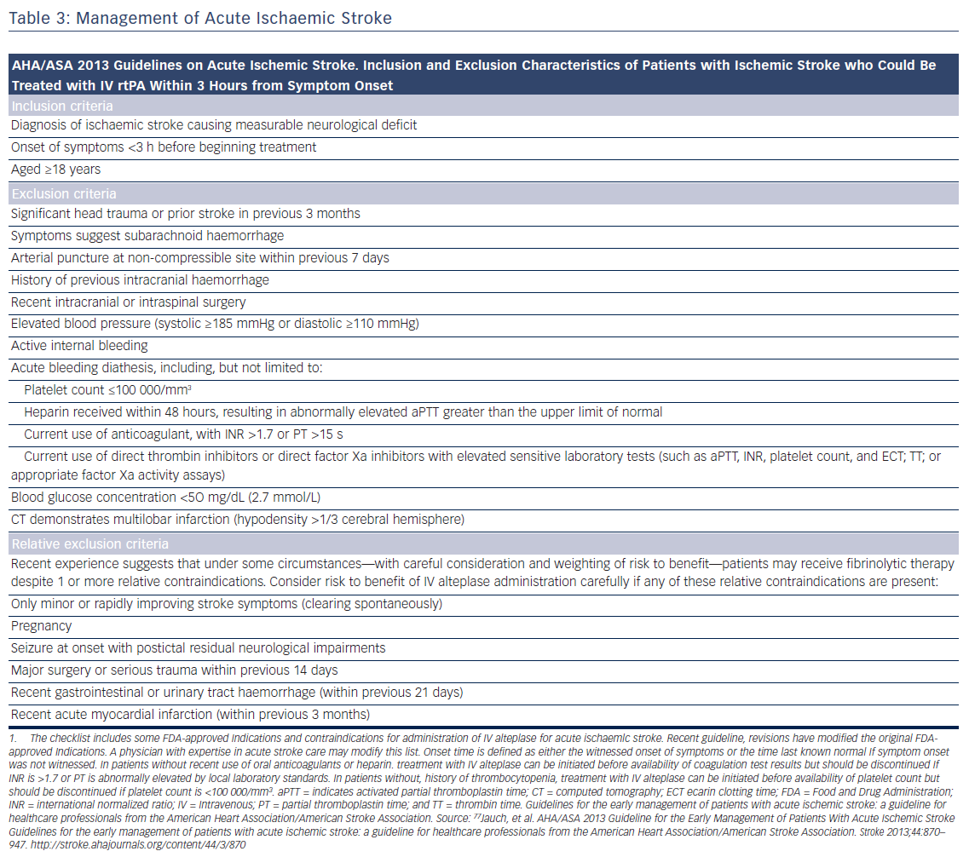
Katritsis GD, Katritsis DG
Table 3: Management of Acute Ischaemic Stroke
Citation: Arrhythmia & Electrophysiology Review 2017;6(4):167–78.
https://doi.org/10.15420/aer.2017.23.1

