Slide 1
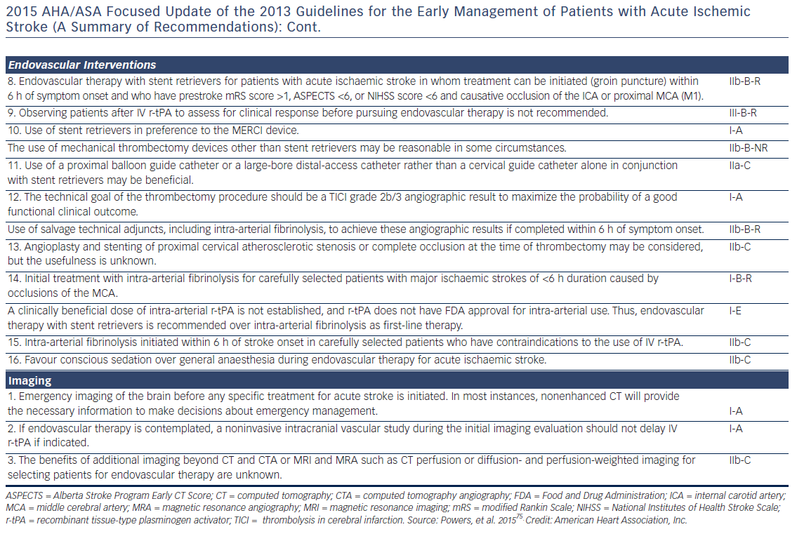
Katritsis GD, Katritsis DG
2015 AHA/ASA Focused Update of the 2013 Guidelines for the Early Management of Patients with Acute Ischemic Stroke Cont.
Citation: Arrhythmia & Electrophysiology Review 2017;6(4):167–78.
https://doi.org/10.15420/aer.2017.23.1

