Slide 1
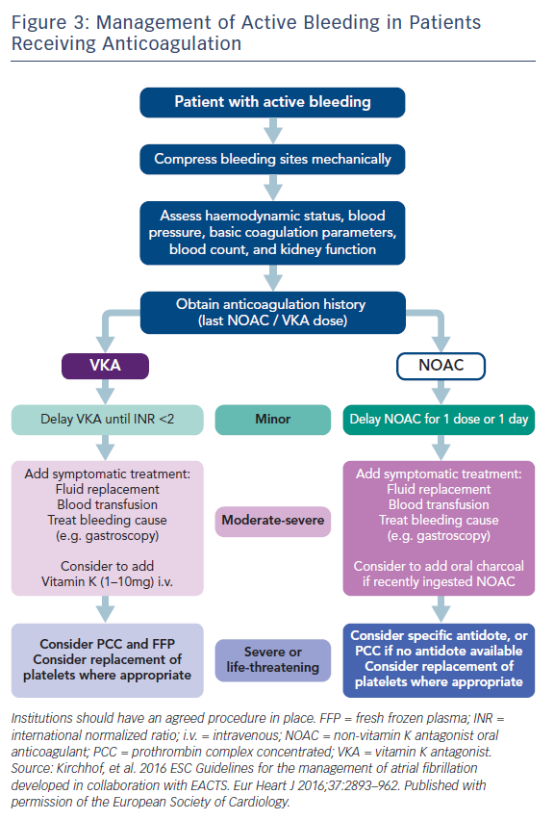
Katritsis GD, Katritsis DG
Figure 3: Management of Active Bleeding in Patients Receiving Anticoagulation
Citation: Arrhythmia & Electrophysiology Review 2017;6(4):167–78.
https://doi.org/10.15420/aer.2017.23.1

