Slide 1
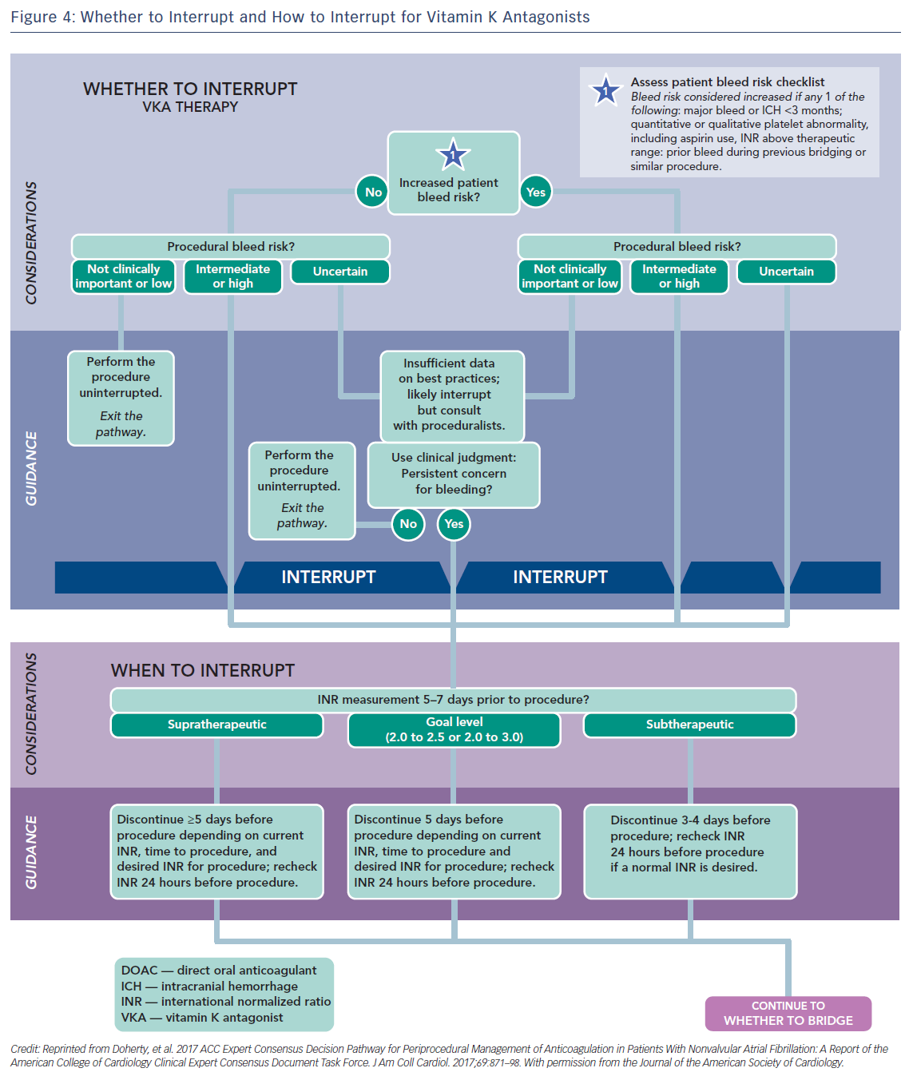
Katritsis GD, Katritsis DG
Figure 4: Whether to Interrupt and How to Interrupt for Vitamin K Antagonists
Citation: Arrhythmia & Electrophysiology Review 2017;6(4):167–78.
https://doi.org/10.15420/aer.2017.23.1

