Slide 1
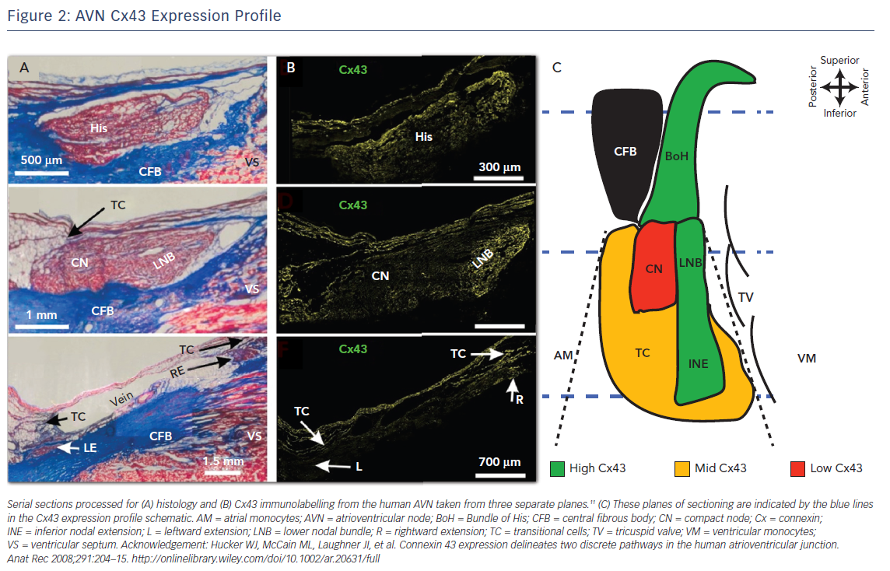
George SA, Faye NR, Murillo-Berlioz A, Lee KB, Trachiotis GD, Efimov IR
Figure 2: AVN Cx43 Expression Profile
Citation: Arrhythmia & Electrophysiology Review 2017;6(4):179–85.
https://doi.org/10.15420/aer.2017.30.1

