Slide 1
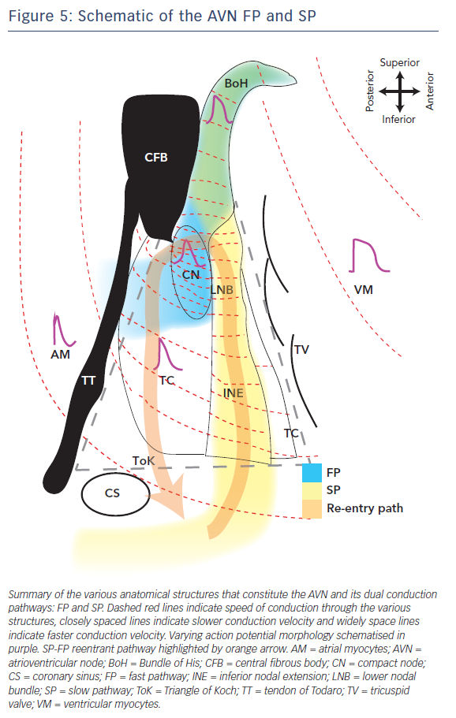
George SA, Faye NR, Murillo-Berlioz A, Lee KB, Trachiotis GD, Efimov IR
Figure 5: Schematic of the AVN FP and SP
Citation: Arrhythmia & Electrophysiology Review 2017;6(4):179–85.
https://doi.org/10.15420/aer.2017.30.1

