Slide 1
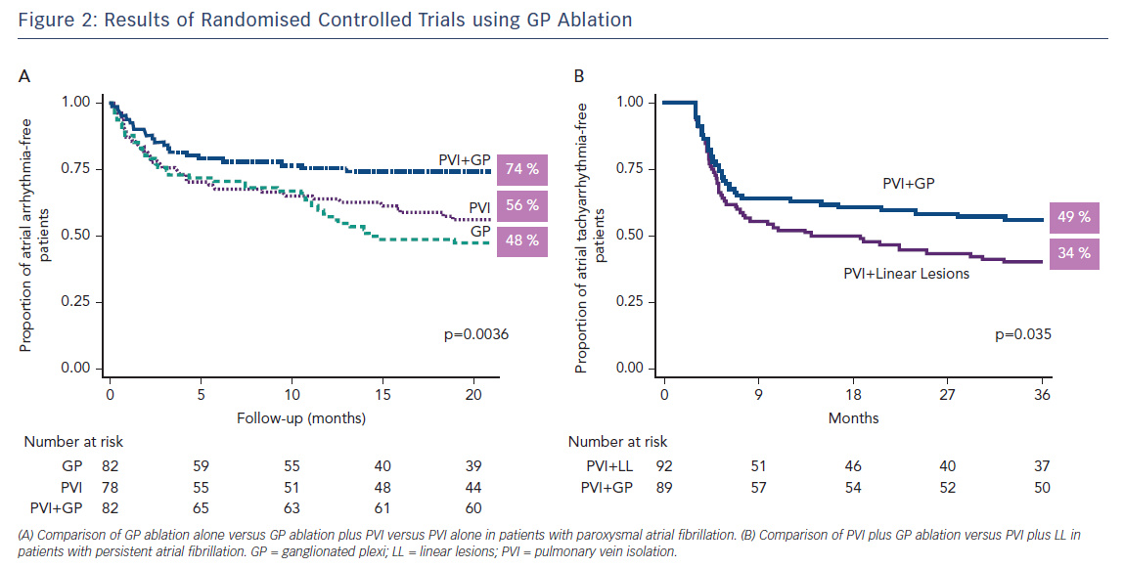
Stavrakis S, Po S
Figure 2: Results of Randomised Controlled Trials using GP Ablation
Citation: Arrhythmia & Electrophysiology Review 2017;6(4):186–90.
https://doi.org/10.15420/aer2017.26.1

