Slide 1
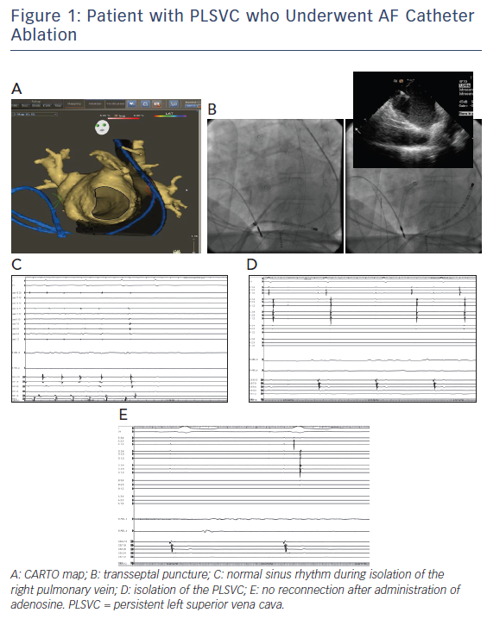
Refaat MM, Ballout J, Mansour M
Figure 1: Patient with PLSVC who Underwent AF Catheter Ablation
Citation: Arrhythmia & Electrophysiology Review 2017;6(4):191–4.
https://doi.org/10.15420/2017.2017.15.1

