Slide 1
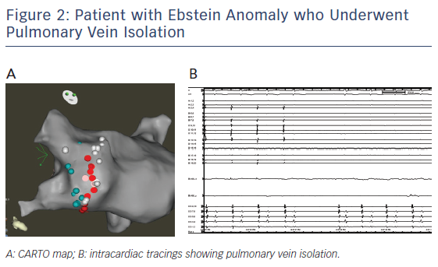
Refaat MM, Ballout J, Mansour M
Figure 2: Patient with Ebstein Anomaly who Underwent Pulmonary Vein Isolation
Citation: Arrhythmia & Electrophysiology Review 2017;6(4):191–4.
https://doi.org/10.15420/2017.2017.15.1

