Slide 1
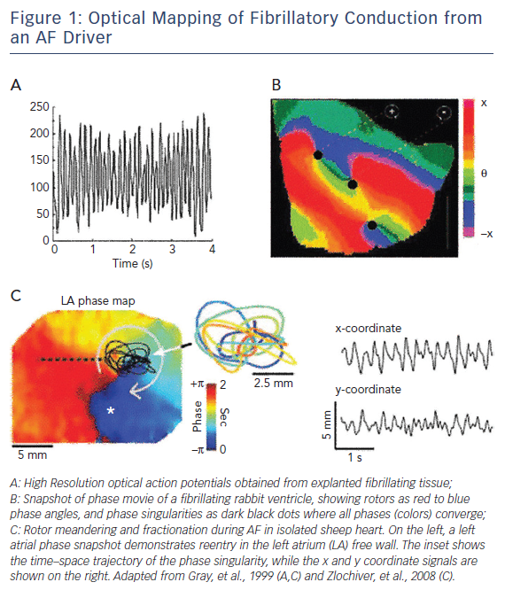
Baykaner T, Zaman JA, Wang PJ, Narayan SM
Optical Mapping of Fibrillatory Conduction from an AF Driver
Citation: Arrhythmia & Electrophysiology Review 2017;6(4):195–201.
https://doi.org/10.15420/2017:28:1

