Slide 1
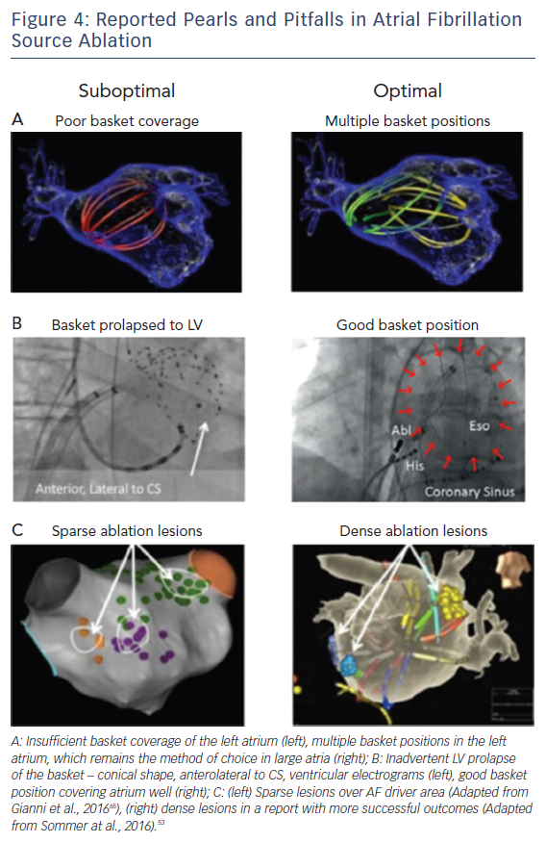
Baykaner T, Zaman JA, Wang PJ, Narayan SM
Reported Pearls &amp; Pitfalls in AF Source Ablation
Citation: Arrhythmia & Electrophysiology Review 2017;6(4):195–201.
https://doi.org/10.15420/2017:28:1

