Slide 1
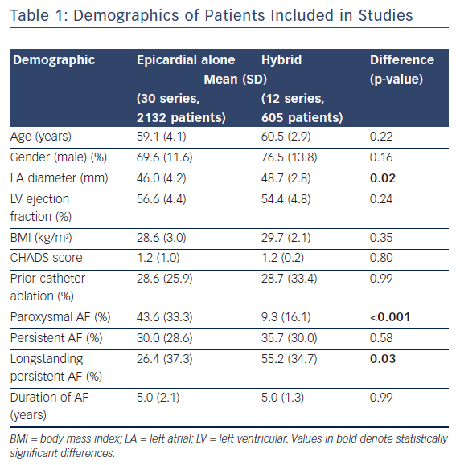
Pearman CM, Poon SS, Bonnett LJ, Haldar S, Wong T, Mediratta N, Gupta D
Table 1: Demographics of Patients Included in Studies
Citation: Arrhythmia & Electrophysiology Review 2017;6(4):202–9.
https://doi.org/10.15420/aer/2017.29.2

