Slide 1
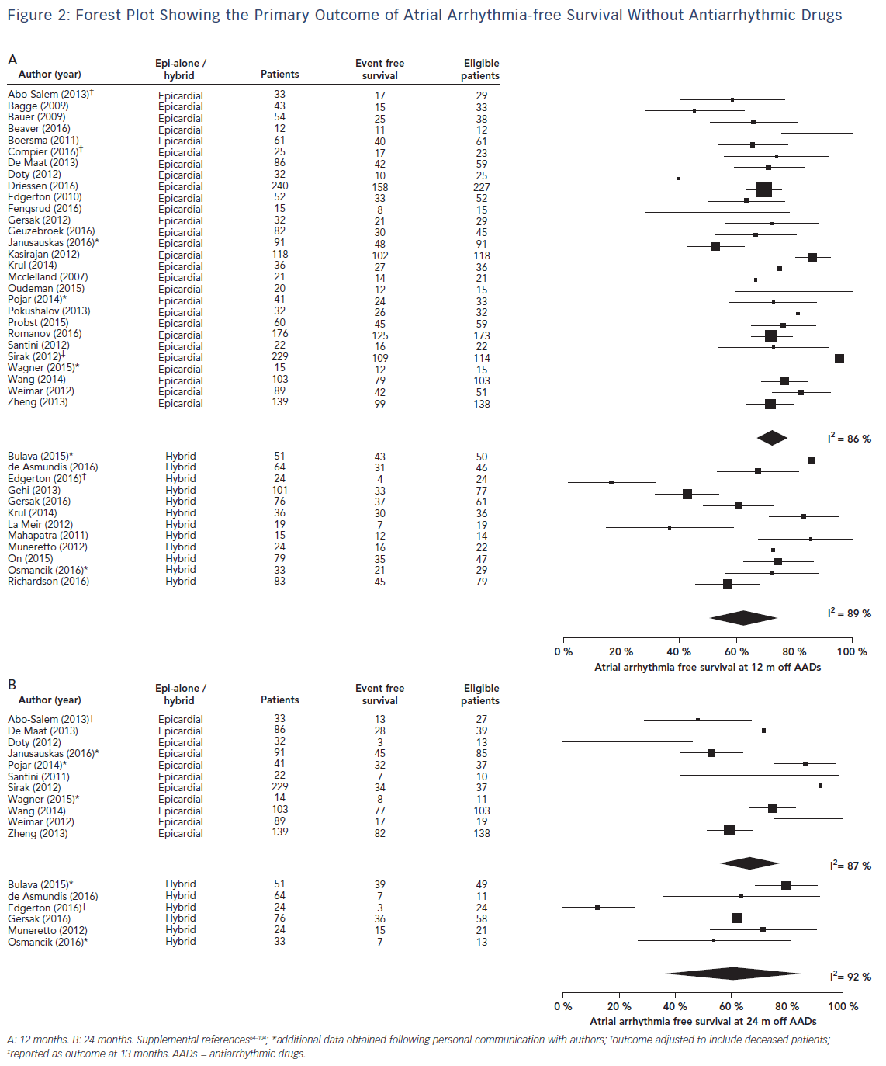
Pearman CM, Poon SS, Bonnett LJ, Haldar S, Wong T, Mediratta N, Gupta D
Figure 2: Forest Plot Showing the Primary Outcome of Atrial Arrhythmia-free Survival Without Antiarrhythmic Drugs
Citation: Arrhythmia & Electrophysiology Review 2017;6(4):202–9.
https://doi.org/10.15420/aer/2017.29.2

