Slide 1
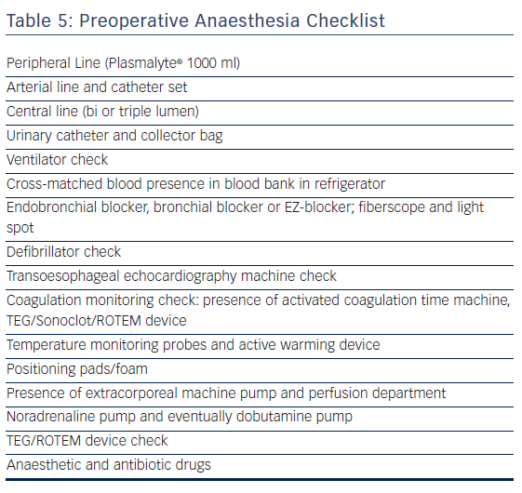
Umbrain V, Verborgh C, Chierchia GB, de Asmundis C, Brugada P, La Meir M
Table 5: Preoperative Anaesthesia Checklist
Citation: Arrhythmia & Electrophysiology Review 2017;6(4):210–6.
https://doi.org/10.15420/2017.36.2

