Slide 1
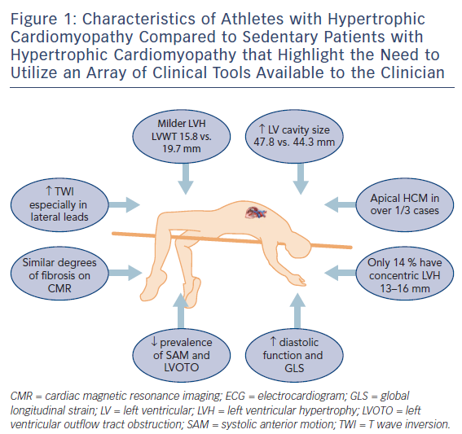
Malhotra A, Sharma S
Figure 1: Characteristics of Athletes with Hypertrophic Cardiomyopathy Compared to Sedentary Patients with Hypertrophic Cardiomyopathy that Highlight the Need to Utilize an Array of Clinical Tools Available to the Clinician
Citation: European Cardiology Review 2017;12(2):80–2
https://doi.org/10.15420/ecr.2017:12:1

