Slide 1
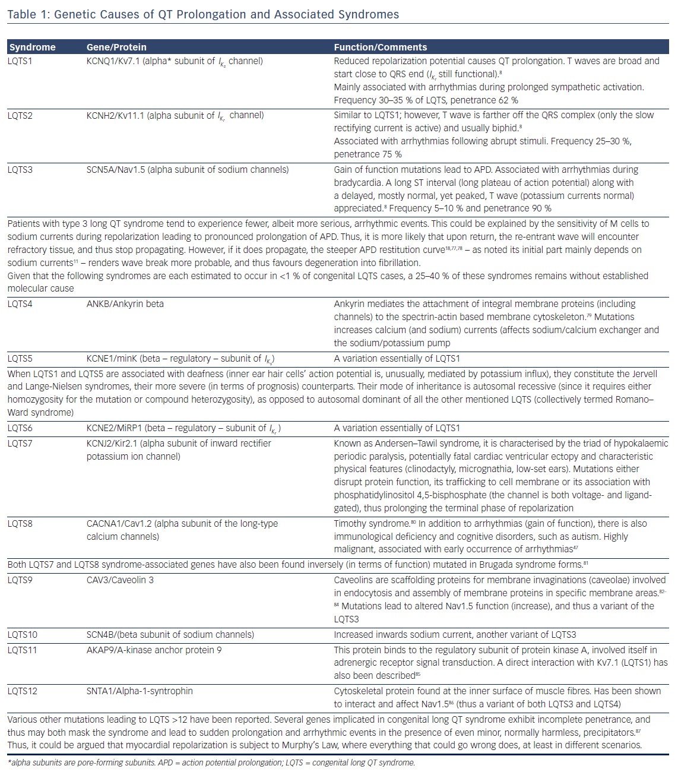
Antoniou CK, Dilaveris P, Manolakou P, Galanakos S, Magkas N, Gatzoulis K, Tousoulis D
Table 1: Genetic Causes of QT Prolongation and Associated Syndromes
Citation: European Cardiology Review 2017;12(2):112–20
https://doi.org/10.15420/ecr.2017:16:1

