Slide 1
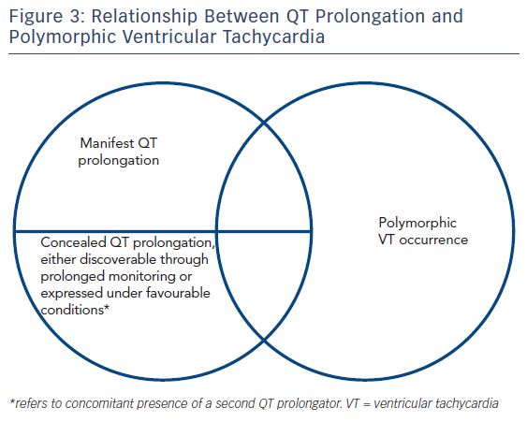
Antoniou CK, Dilaveris P, Manolakou P, Galanakos S, Magkas N, Gatzoulis K, Tousoulis D
Figure 3: Relationship Between QT Prolongation and Polymorphic Ventricular Tachycardia
Citation: European Cardiology Review 2017;12(2):112–20
https://doi.org/10.15420/ecr.2017:16:1

