Slide 1
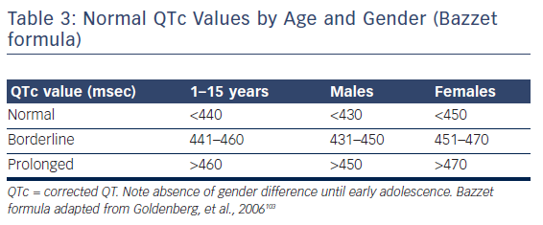
Antoniou CK, Dilaveris P, Manolakou P, Galanakos S, Magkas N, Gatzoulis K, Tousoulis D
Table 3: Normal QTc Values by Age and Gender (Bazzet formula). QTc Women and Men.
Citation: European Cardiology Review 2017;12(2):112–20
https://doi.org/10.15420/ecr.2017:16:1

