Slide 1
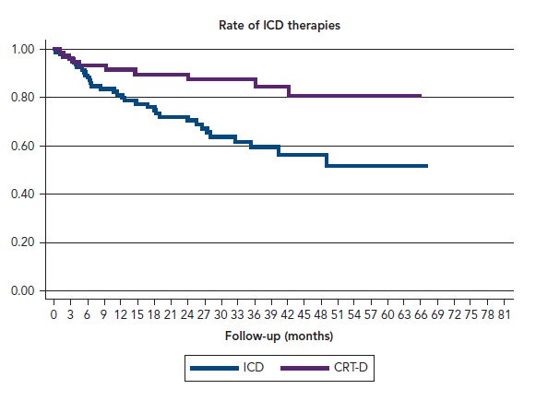
Oristrell G, Galve E, Acosta JG, Rivera A, Moya A, Ferreira Gonzalez I, Perez-Rodon J, Garcia-Dorado D
Rate of ICD therapies
Citation: European Cardiology Review 2017;12(2):93.
https://doi.org/10.15420/ecr.2017:23:2

