Slide 1

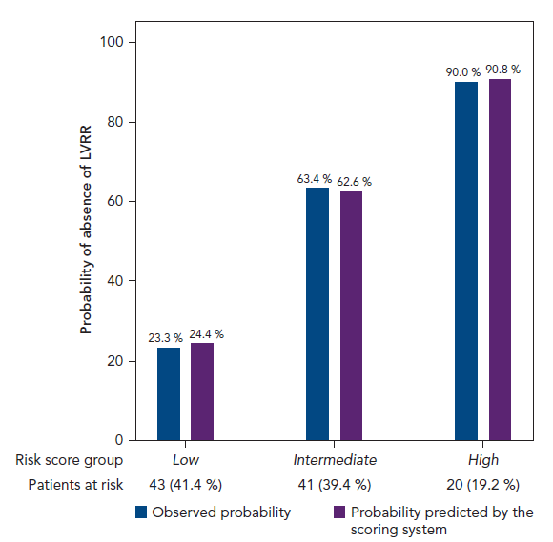
Perez-Rodon J, Galve E, Pérez-Bocanegra C, Soriano-Sánchez T, Recio-Iglesias J, Domingo-Baldrich E, Alzola-Guevara M, Ramon Marsala J, Ribera-Solé A, García-Moreno LG, Cruz-Carlos LM, Rivas-Gandara N, Roca-Luque I, Francisco-Pascual J, Evangelista-Masip A, Moya-Mitjans �, Garcia-Dorado D
Risk Score Group
Citation: European Cardiology Review 2017;12(2):99.
https://doi.org/10.15420/ecr.2017:23:8

