Slide 1
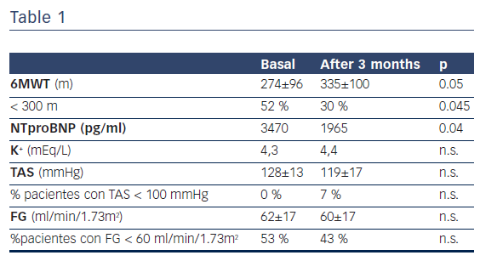
Faraudo M, Beltran P, Freixa Pamias R, Mena Sebastià E, Guri O, Contra A, Miguel Ceresuela L, Masip J
Does Angiotensin Receptor Neprilysin Inhibitor
Citation: European Cardiology Review 2017;12(2):100.
https://doi.org/10.15420/ecr.2017:23:9

