Slide 1
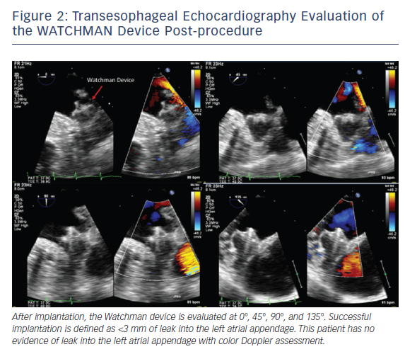
Arjoon R, Brogan A, Sugeng L
Figure 2: Transesophageal Echocardiography Evaluation of the WATCHMAN Device Post-procedure
Citation: US Cardiology Review 2018;12(1):22–7.
https://doi.org/10.15420/usc.2017:16:1

