Slide 1
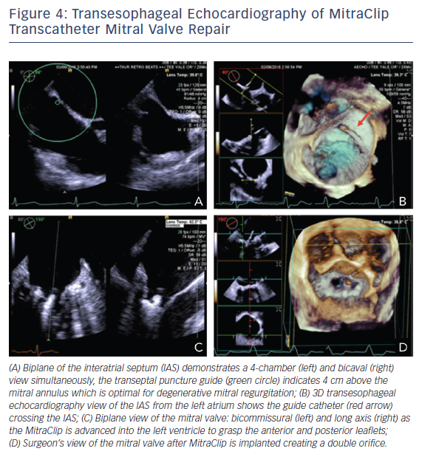
Arjoon R, Brogan A, Sugeng L
Figure 4: Transesophageal Echocardiography of MitraClip Transcatheter Mitral Valve Repair
Citation: US Cardiology Review 2018;12(1):22–7.
https://doi.org/10.15420/usc.2017:16:1

