Slide 1
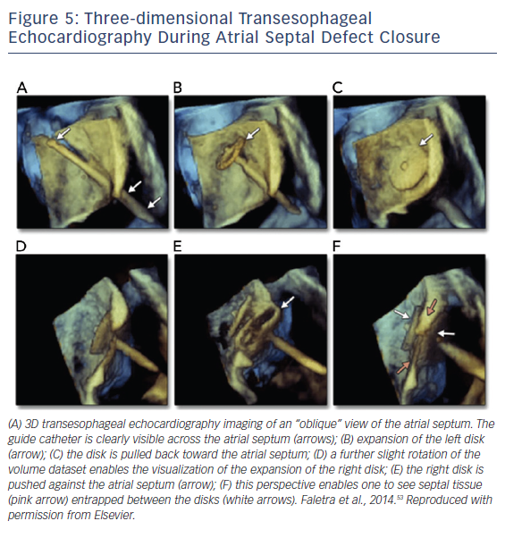
Arjoon R, Brogan A, Sugeng L
Figure 5: Three-dimensional Transesophageal Echocardiography During Atrial Septal Defect Closure
Citation: US Cardiology Review 2018;12(1):22–7.
https://doi.org/10.15420/usc.2017:16:1

