Slide 1
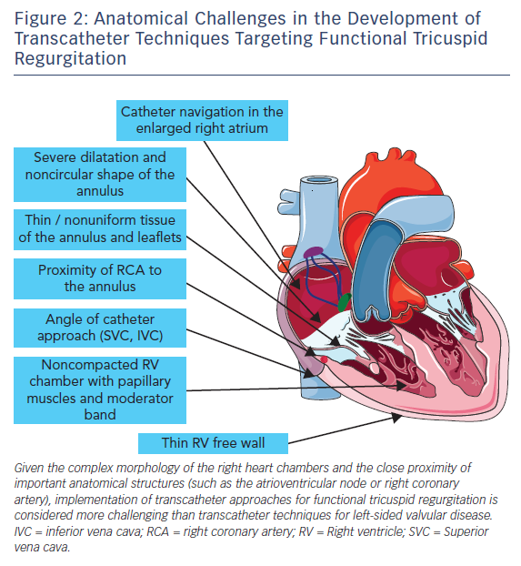
Besler C, Meduri CU, Lurz P
Figure 2: Anatomical Challenges in the Development of Transcatheter Techniques Targeting Functional Tricuspid Regurgitation
Citation: Interventional Cardiology Review 2018;13(1):8–13.
https://doi.org/10.15420/icr.2017:21:1

