Slide 1
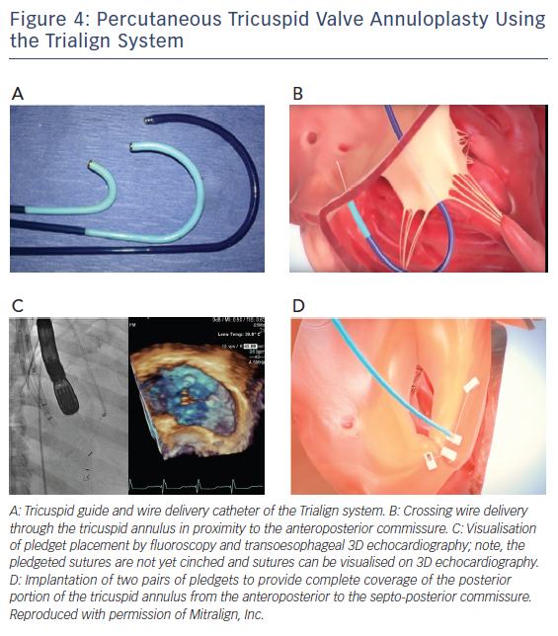
Besler C, Meduri CU, Lurz P
Figure 4: Percutaneous Tricuspid Valve Annuloplasty Using the Trialign System
Citation: Interventional Cardiology Review 2018;13(1):8–13.
https://doi.org/10.15420/icr.2017:21:1

