Slide 1
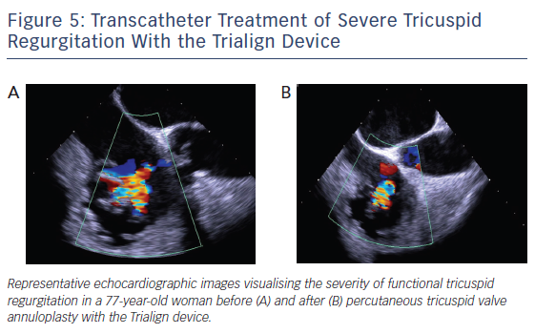
Besler C, Meduri CU, Lurz P
Figure 5: Transcatheter Treatment of Severe Tricuspid Regurgitation With the Trialign Device
Citation: Interventional Cardiology Review 2018;13(1):8–13.
https://doi.org/10.15420/icr.2017:21:1

