Slide 1
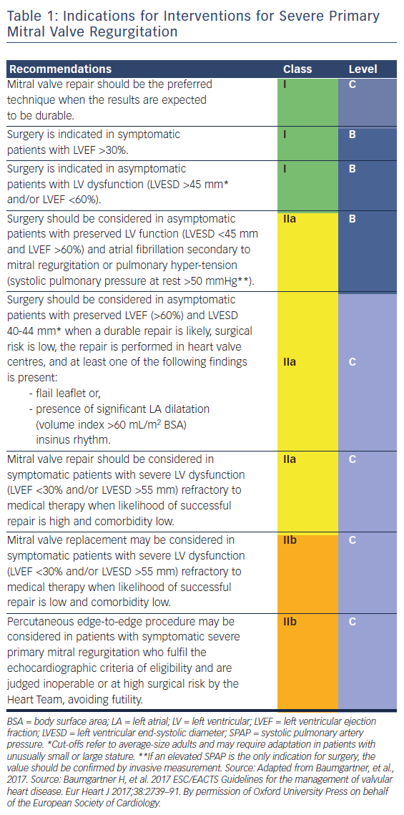
Van Praet KM, Stamm C, Sündermann SH, Meyer A, Unbehaun A, Montagner M, Nazari Shafti TZ, Jacobs S, Falk V, Kempfert J
Table 1: Indications for Interventions for Severe Primary Mitral Valve Regurgitation
Citation: Interventional Cardiology Review 2018;13(1):14–9.
https://doi.org/10.15420/icr.2017:30:1

