Slide 1
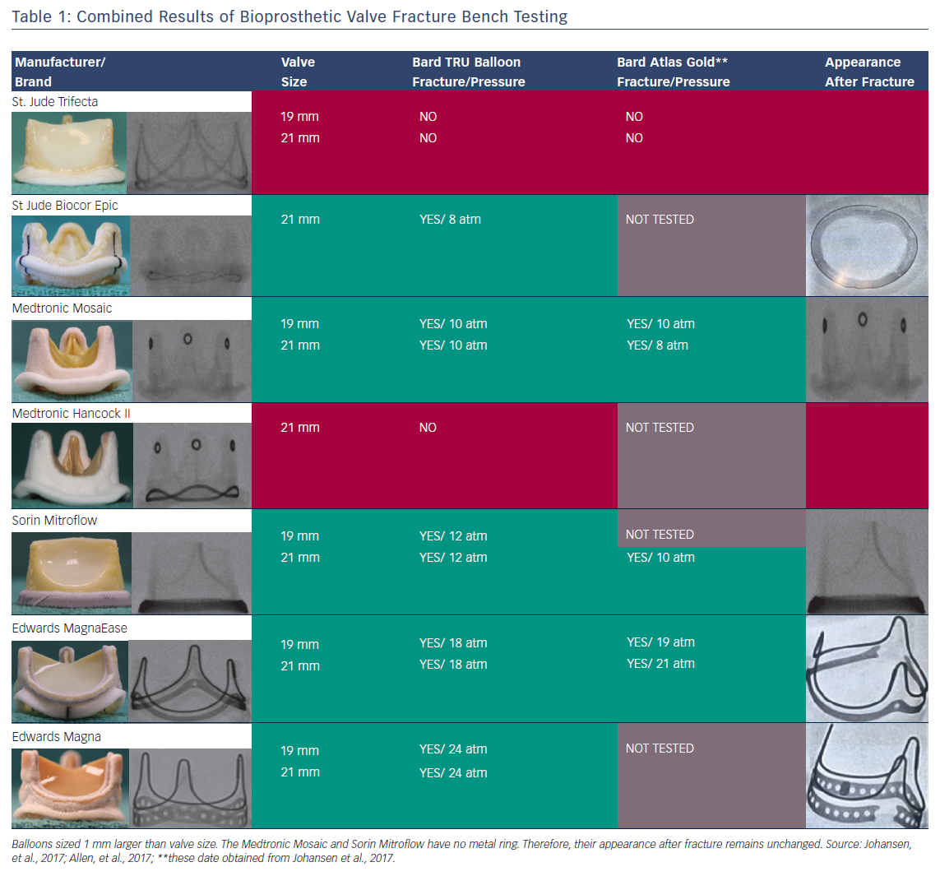
Saxon JT, Allen KB, Cohen DJ, Chhatriwalla AK
Table 1: Combined Results of Bioprosthetic Valve Fracture Bench Testing
Citation: Interventional Cardiology Review 2018;13(1):20–6.
https://doi.org/10.15420/icr.2017:29:1

