Slide 1
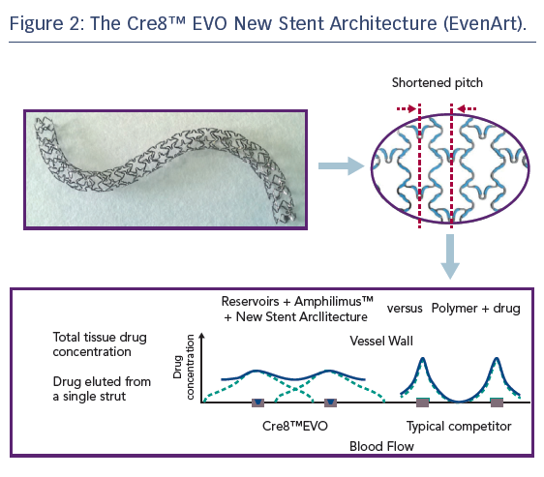
Byrne RA, Banai S, Colleran R, Colombo A
Figure 2: The Cre8™ EVO New Stent Architecture (EvenArt)
Citation: Interventional Cardiology Review 2018;13(1):40–4.
https://doi.org/10.15420/icr.2017:27:1

