Slide 1
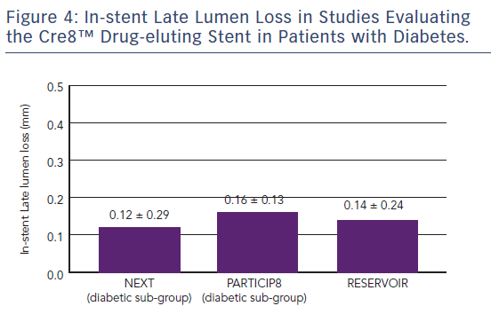
Byrne RA, Banai S, Colleran R, Colombo A
Figure 4: In-stent Late Lumen Loss in Studies Evaluating the Cre8™ Drug-eluting Stent in Patients with Diabetes
Citation: Interventional Cardiology Review 2018;13(1):40–4.
https://doi.org/10.15420/icr.2017:27:1

