Slide 1
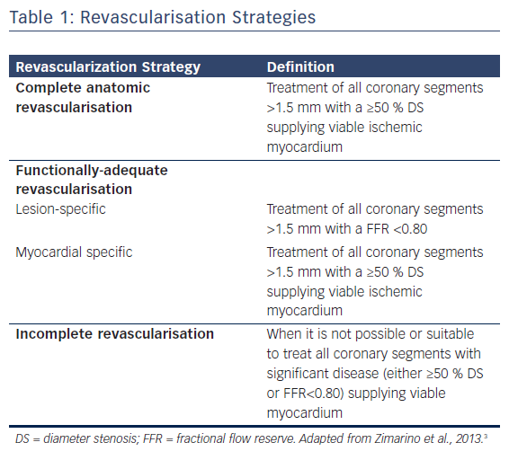
De Caterina R, De Innocentiis C, Zimarino M
Table 1: Revascularisation Strategies
Citation: Interventional Cardiology Review 2018;13(1):45–50.
https://doi.org/10.15420/icr.2017:23:1

