Slide 1
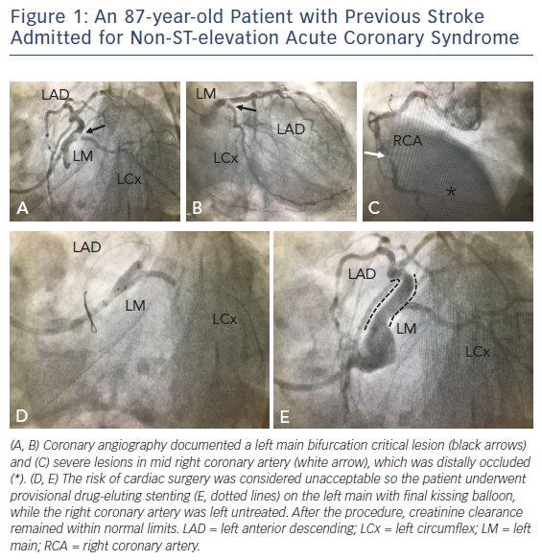
De Caterina R, De Innocentiis C, Zimarino M
Figure 1: An 87-year-old Patient with Previous Stroke Admitted for Non-ST-elevation Acute Coronary Syndrome
Citation: Interventional Cardiology Review 2018;13(1):45–50.
https://doi.org/10.15420/icr.2017:23:1

