Slide 1
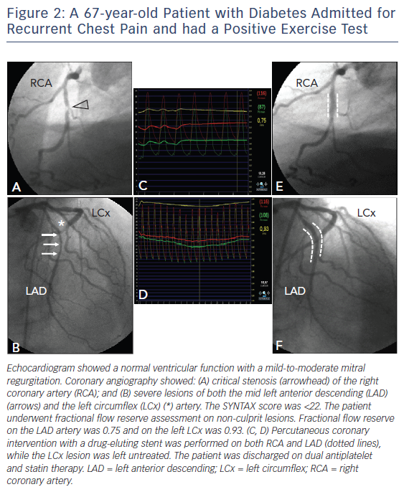
De Caterina R, De Innocentiis C, Zimarino M
Figure 2: A 67-year-old Patient with Diabetes Admitted for Recurrent Chest Pain and had a Positive Exercise Test
Citation: Interventional Cardiology Review 2018;13(1):45–50.
https://doi.org/10.15420/icr.2017:23:1

