Slide 1
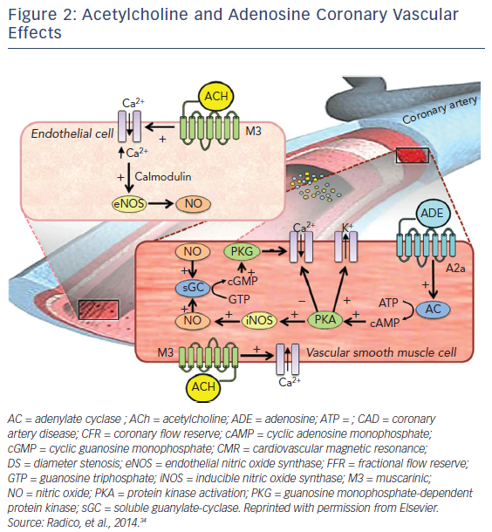
Alrifai A, Kabach M, Nieves J, Pino J, Chait R
Figure 2: Acetylcholine and Adenosine Coronary Vascular Effects
Citation: US Cardiology Review 2018;12(1):41–5.
https://doi.org/10.15420/usc.2017:27:1

