Slide 1
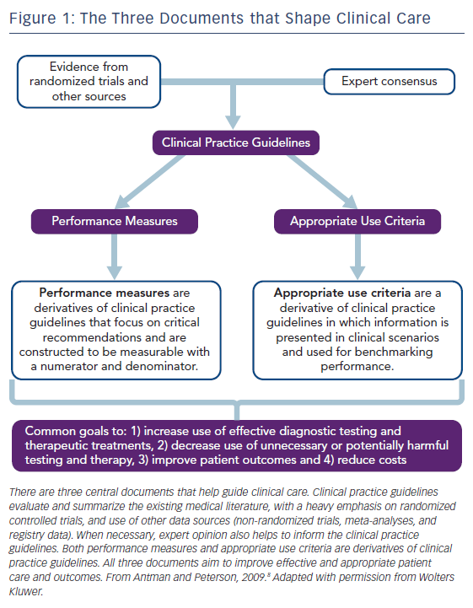
Dehmer GJ, White L, Doherty JU
Figure 1: The Three Documents that Shape Clinical Care
Citation: US Cardiology Review 2018;12(1):36–40.
https://doi.org/10.15420/usc.2017:29:1

