Slide 1
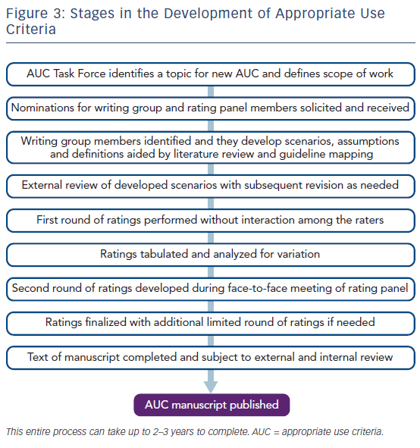
Dehmer GJ, White L, Doherty JU
Figure 3: Stages in the Development of Appropriate Use Criteria
Citation: US Cardiology Review 2018;12(1):36–40.
https://doi.org/10.15420/usc.2017:29:1

