Slide 1
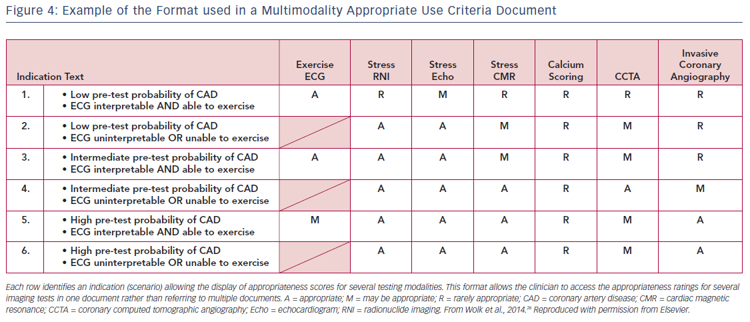
Dehmer GJ, White L, Doherty JU
Figure 4: Example of the Format used in a Multimodality Appropriate Use Criteria Document
Citation: US Cardiology Review 2018;12(1):36–40.
https://doi.org/10.15420/usc.2017:29:1

