Slide 1
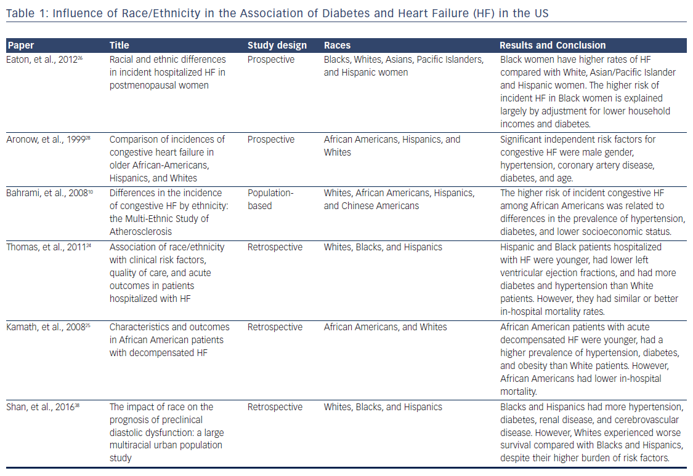
Tee Lu H, Bin Nordin R, Abdul Rahim AAB
Table 1: Influence of Race/Ethnicity in the Association of Diabetes and Heart Failure (HF) in the US
Citation: US Cardiology Review 2018;12(1):17–21.
https://doi.org/10.15420/usc.2017:24:2

