Slide 1
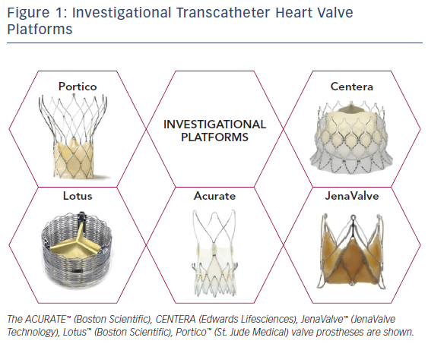
Young MN, Elmariah S
Figure 1: Investigational Transcatheter Heart Valve Platforms
Citation: US Cardiology Review 2018;12(1):28–32.
https://doi.org/10.15420/usc.2017:25:2

