Slide 1
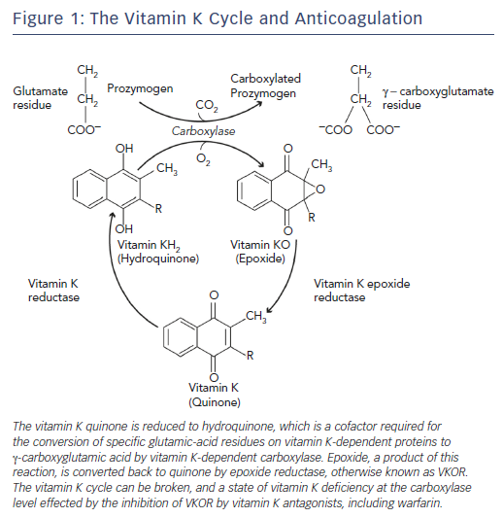
Vranckx P, Valgimigli M, Heidbuchel H
Figure 1: The Vitamin K Cycle and Anticoagulation
Citation: Arrhythmia & Electrophysiology Review 2018;7(1):55–61.
https://doi.org/10.15420/aer.2017.50.1

